Slide 1
Exception Handling in Java
The exception handling in java is one of the powerful mechanism to handle the runtime errors so that normal flow of the application can be maintained.

Slide 2
What is exception
Dictionary Meaning: Exception is an abnormal condition.
In java, exception is an event that disrupts the normal flow of the program.
It is an object which is thrown at runtime.

Slide 3
Advantage of Exception Handling
The core advantage of exception handling is to maintain the normal flow of the application.
Exception normally disrupts the normal flow of the application that is why we use exception handling.
Suppose there is 6 statements in your program and there occurs an exception at statement 3, rest of the code will not be executed i.e. statement 4 to 6 will not run. If we perform exception handling, rest of the statement will be executed. That is why we use exception handling in java.
Let's take a scenario:
statement 1;
statement 2;
statement 3; //exception occurs
statement 4;
statement 5;
statement 6;

Slide 4
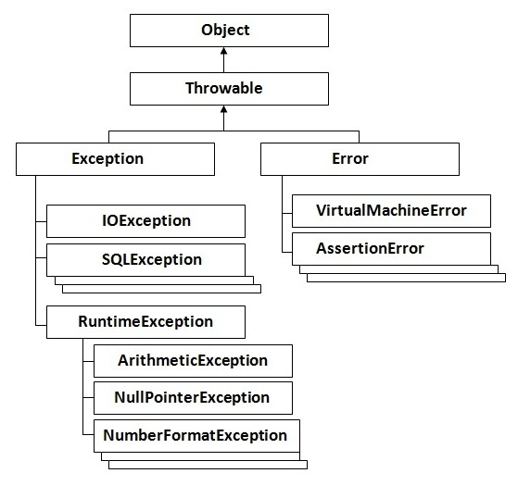
Hierarchy of Java Exception classes

Slide 5
Types of Exception
There are mainly two types of exceptions:
checked and unchecked where error is considered as unchecked exception.
The sun microsystem says there are three types of exceptions:
Checked Exception
Unchecked Exception
Error

Slide 6
1) Checked Exception
The classes that extend Throwable class except RuntimeException and Error are known as checked exceptions
e.g.IOException, SQLException etc.
Checked exceptions are checked at compile-time.

Slide 7
2) Unchecked Exception
The classes that extend RuntimeException are known as unchecked exceptions
e.g. ArithmeticException, NullPointerException, ArrayIndexOutOfBoundsException etc.
Unchecked exceptions are not checked at compile-time rather they are checked at runtime.

Slide 8
3) Error
Error is irrecoverable
e.g. OutOfMemoryError, VirtualMachineError, AssertionError etc.

Slide 9
Common scenarios where exceptions may occur
There are given some scenarios where unchecked exceptions can occur. They are as follows:
1) Scenario where ArithmeticException occurs
If we divide any number by zero, there occurs an ArithmeticException.
int a=50/0;//ArithmeticException

Slide 10
2) Scenario where NullPointerException occurs
If we have null value in any variable, performing any operation by the variable occurs an NullPointerException.
String s=null;
System.out.println(s.length());//NullPointerException

Slide 11
3) Scenario where NumberFormatException occurs
The wrong formatting of any value, may occur NumberFormatException.
Suppose I have a string variable that have characters, converting this variable into digit will occur NumberFormatException.
String s="abc";
int i=Integer.parseInt(s);//NumberFormatException

Slide 12
4) Scenario where ArrayIndexOutOfBoundsException occurs
f you are inserting any value in the wrong index, it would result ArrayIndexOutOfBoundsException as shown below:
int a[]=new int[5];
a[10]=50; //ArrayIndexOutOfBoundsException

Slide 13
Java Exception Handling Keywords
There are 5 keywords used in java exception handling.
try
catch
finally
throw
throws

Slide 14
Which of these access specifiers can be used for an interface?
a) Public b) Protected c) private d) Unspecified

Slide 15
interface Test{
int p = 10; //line 1
public int q = 20; //line 2
public static int r = 30; //line 3
public static final int s = 40; //line 4
}
Which of the above line will give compilation error?
A. 1
B. 2
C. 3
D. 4
E. None of these

Slide 16
None

Slide 17
interface TestInf{
int i =10;
}
class Test{
public static void main(String... args){
TestInf.i=12;
System.out.println(TestInf.i);
}
}
10
12
Compilation error

Slide 18
Compilation error Final

Slide 19
MCQ
class Test{
public static void main(String args[]){
A a = new B();
a.printValue();
System.out.print(a.i);
}}
Value-A, 10
Value-A, 11
Value-B, 10
Value-B, 11
class A{
int i = 10;
public void printValue(){
System.out.print("Value-A");
}
}
class B extends A{
int i = 11;
public void printValue(){
System.out.print("Value-B");
}
}

Slide 20
Ans: B. Value-B 10

Slide 21
class A{
int i = 10;
public void printValue(){
System.out.print("Value-A");
}
}
class B extends A{
int i = 11;
public void printValue(){
System.out.print("Value-B");
}
}
class Test{
public static void main(String args[]){
B a = new B();
a.printValue();
System.out.print(a.i);
}}
Value-A, 10
Value-A, 11
Value-B, 10
Value-B, 11

Slide 22
Ans: B. Value-B 11

Slide 23
class A{
int i = 10;
}
class B extends A{
int i = 11;
public void printValue(){
System.out.print("Value-B");
}}
class Test{
public static void main(String args[]){
A a = new B();
a.printValue();
System.out.print(a.i);
}}
Compilation error
Value-A, 11
Value-B, 10
Value-B, 11

Slide 24
Ans: Compilation error

Slide 25
Which of these access specifiers can be used for an interface?
a) Public b) Protected c) private d) Unspecified

Slide 26
Ans: a and d

Slide 27
interface A{
int i=5;
public void method();
}
class One implements A{
int i=6;
public void method(){
System.out.println("Class One method");
}
}
class Two extends One{
int i=7;
public void method(){
System.out.println("Class Two method1");
}
}
class Test extends Two{
public static void main(String[] args){
One a = new Two();
a.method();
System.out.println(a.i);
}
}
Class two method, 5
Class two method, 6
Class two method 7
Class one method 5

Slide 28
Ans: Class two method, 6

